Slide 1




Web Framework Programming
Topic:
Create Retrieve
Update Delete
In Complex Case Study
WEEK 11 Informatics Engineering
Universitas Surabaya
Informatics Engineering | Universitas Surabaya
Notes:
Cover Half
Gambar vector bisa didownload di: https://scale.flexiple.com/illustrations/
Jika ingin foto free royalty bisa download di: https://pixabay.com/photos/

Slide 2
Many-to-Many Relationship
https://laravel.com/docs/10.x/eloquent-relationships#many-to-many
Informatics Engineering | Universitas Surabaya

Slide 3
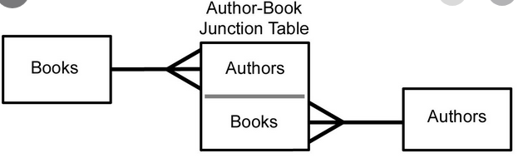
Many-to-Many Relationship Example
The normalization of the Many-to-many is different from that of the one-to-many. In many-to-many relationship will produces 1 new table junction (table junction) which acts as an intermediary between 2 related tables.
Informatics Engineering | Universitas Surabaya

Slide 4
Another example
Relation between User and Role. A specific user can have various roles, and conversely a specific role can consist of many accounts/users.
In e-commerce system, this relationship also occurs in transactions where one sale/order transaction consists of many variants of goods/services.
Informatics Engineering | Universitas Surabaya

Slide 5
Rule of Naming
From definition of a many-to-many relationship, the rule name of table junction is
(a) singular for each table name;
(b) in alphabetical order;
(c) separated by underscore (_)
Example:
Users and roles → role_user
Books and authors → author_book
Informatics Engineering | Universitas Surabaya

Slide 6
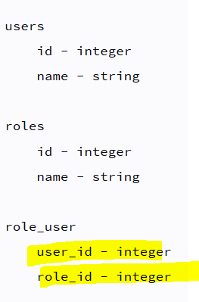
Column Structure from Junction Table
The naming of the junction table column is based on the singular table of each table name with the addition of “_id”.
Each of these columns becomes a Primary key and Foreign Key.
Informatics Engineering | Universitas Surabaya

Slide 7
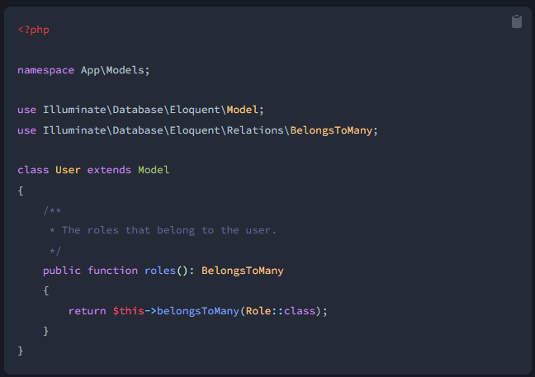
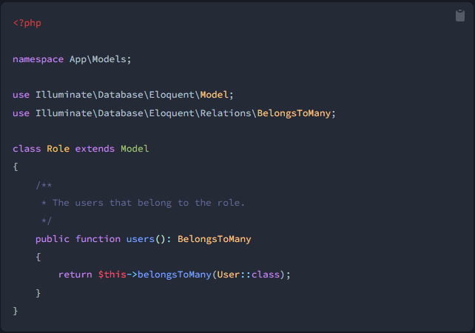
Model Structure
To define a many-to-many relationship, Laravel provides the belongsToMany(…..) keyword.
If you look at the examples of users and roles, then the form of the relationship is as follows:
Both in terms of Users and Roles have the same keywords
Informatics Engineering | Universitas Surabaya

Slide 8
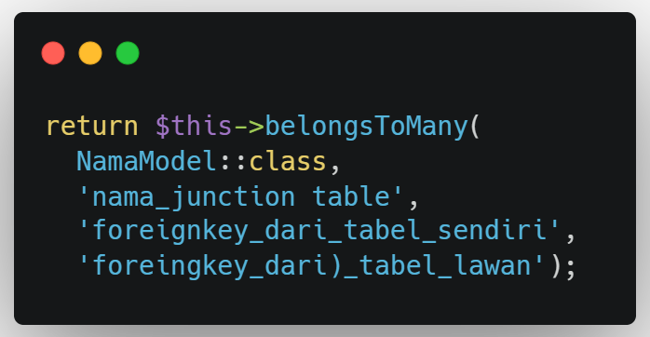
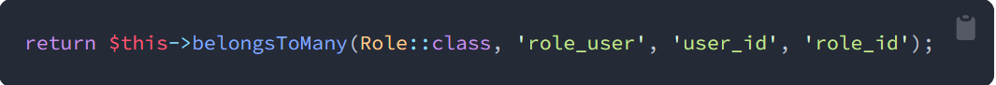
Overriding Mechanism
If the column names or table names don't match the Laravel name convention, you can use
If you look at the example above, belongsToMany is placed in the User model
Informatics Engineering | Universitas Surabaya

Slide 9
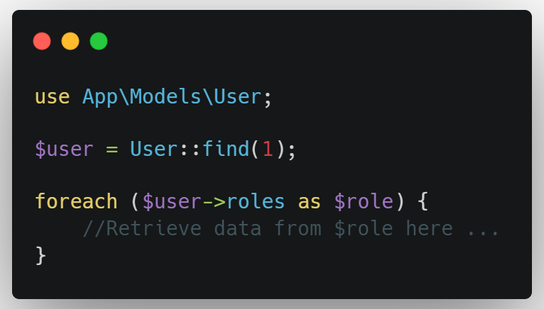
Accessing many-to-many relationship
User Model Structure
Therefore, to receive data roles, you can access as follow:
Informatics Engineering | Universitas Surabaya

Slide 10
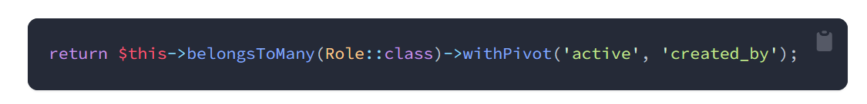
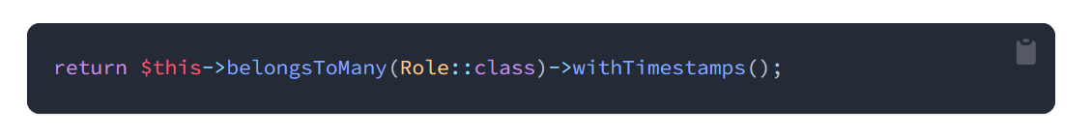
If the junction table has extra columns/parameters
And if the junction table has created_at & updated_at and Laravel eloquent needs to maintain this then pass the keyword withTimestamps
Informatics Engineering | Universitas Surabaya

Slide 11
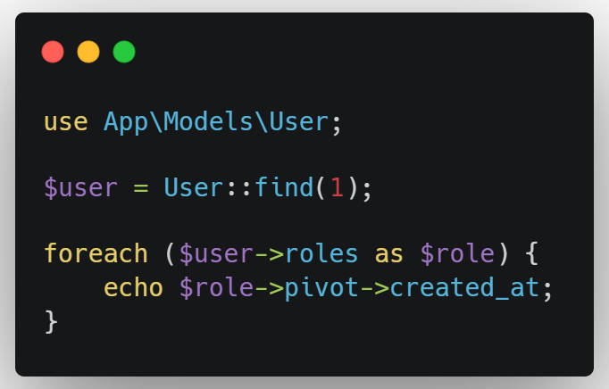
Retrieve data in the column that is in the junction table
The junction table does not only contain foreignkey columns from related tables. You can use the 'pivot' keyword
In the case above, you want to see what time of user with id = 1 was created
The created_at shown is in the table junction (i.e. role_user)
.
Informatics Engineering | Universitas Surabaya

Slide 12
Adaptation of Transaction Database Structure in Our Case Study
Informatics Engineering | Universitas Surabaya

Slide 13

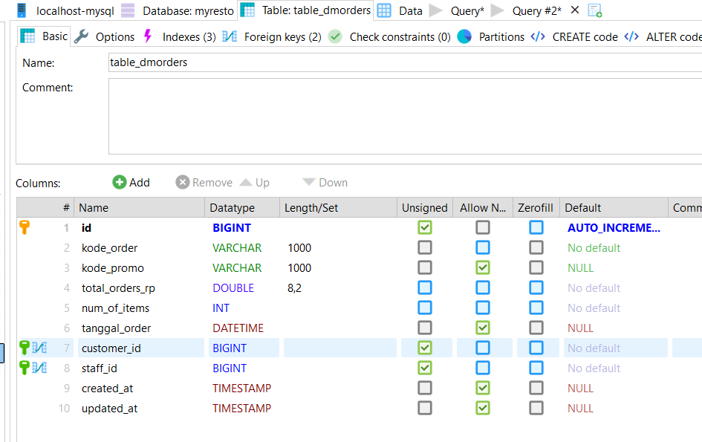
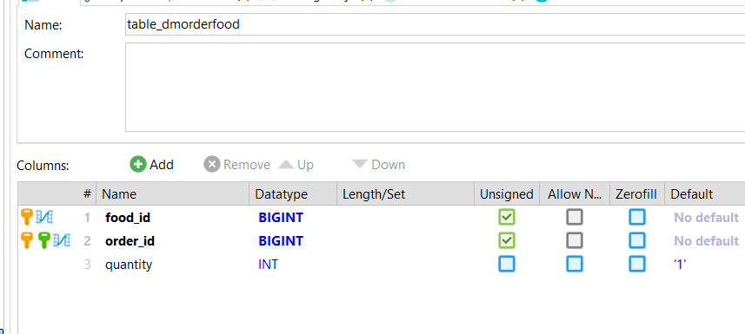
Download your file migrations in ULS
Run our migration for this example
Check your database
Informatics Engineering | Universitas Surabaya

Slide 14
Create Resource Controller and Model for Customer, Transactions Order
Informatics Engineering | Universitas Surabaya

Slide 15
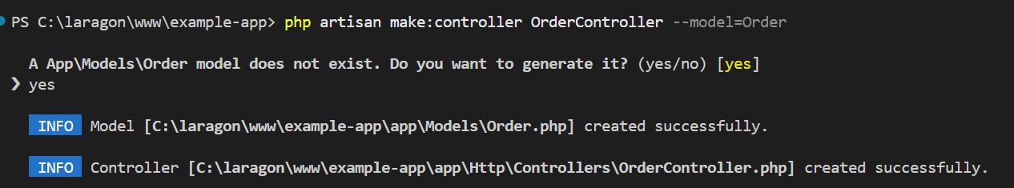
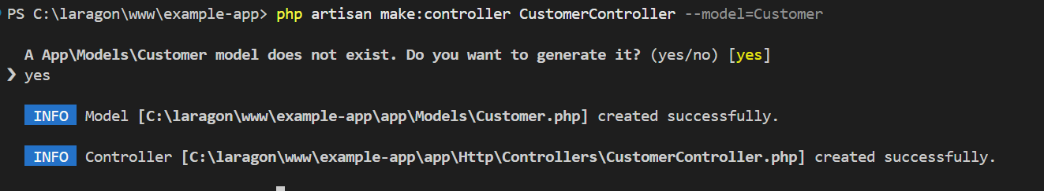
Informatics Engineering | Universitas Surabaya

Slide 16
Define Relation between your Model with Pivot
Informatics Engineering | Universitas Surabaya

Slide 17
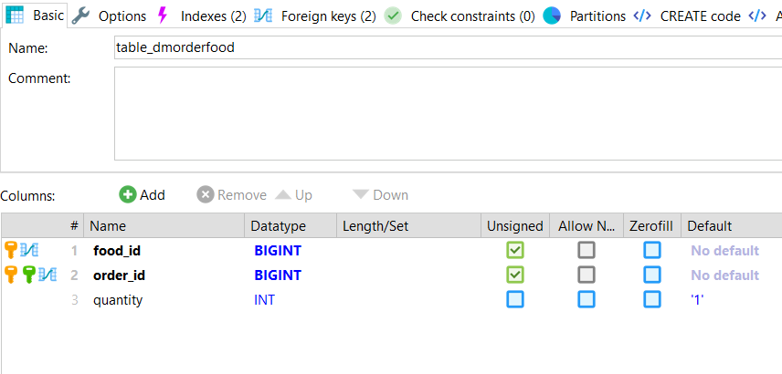
Create Many-to-many Relationship https://laravel.com/docs/10.x/eloquent-relationships#many-to-many
We need to call “pivot” after Relationship to access the intermediate table
Intermediate Table
Pivot Column of
Order X Foods Intermediate table
Informatics Engineering | Universitas Surabaya

Slide 18
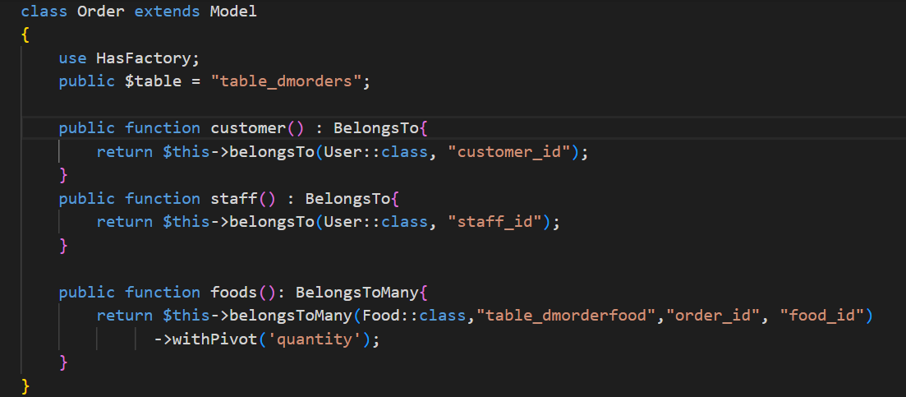
Order Model
1
2
3
4
Note:
The name of intermediated table
The column from the primary/foreingkey of this Model (in this case “order”)
The column from the primary/foreingkey of another Model (in this case “food”)
The column from pivot table that will be show in Query Eloquent
Informatics Engineering | Universitas Surabaya

Slide 19
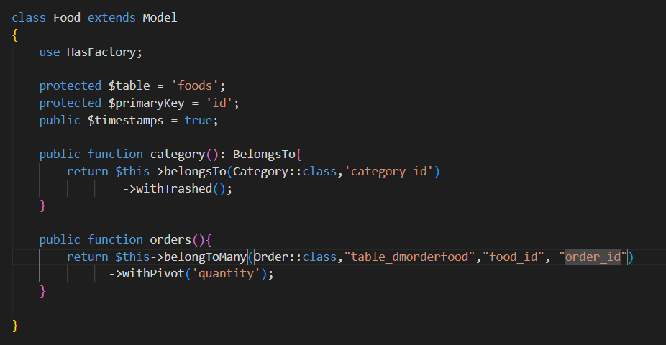
Food Model
A new function represents the many-to-many relation between orders x foods
Informatics Engineering | Universitas Surabaya

Slide 20
How to call Pivot in your Table?
Informatics Engineering | Universitas Surabaya

Slide 21
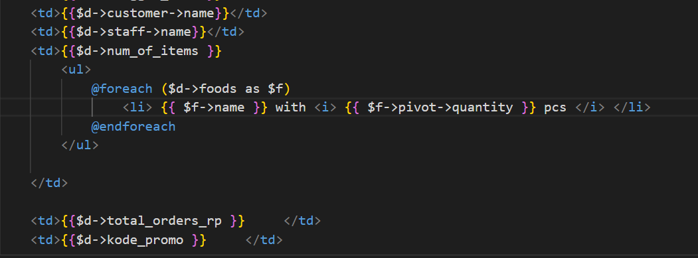
Order / index.blade.php
Pivot for detailing information
Informatics Engineering | Universitas Surabaya

Slide 22
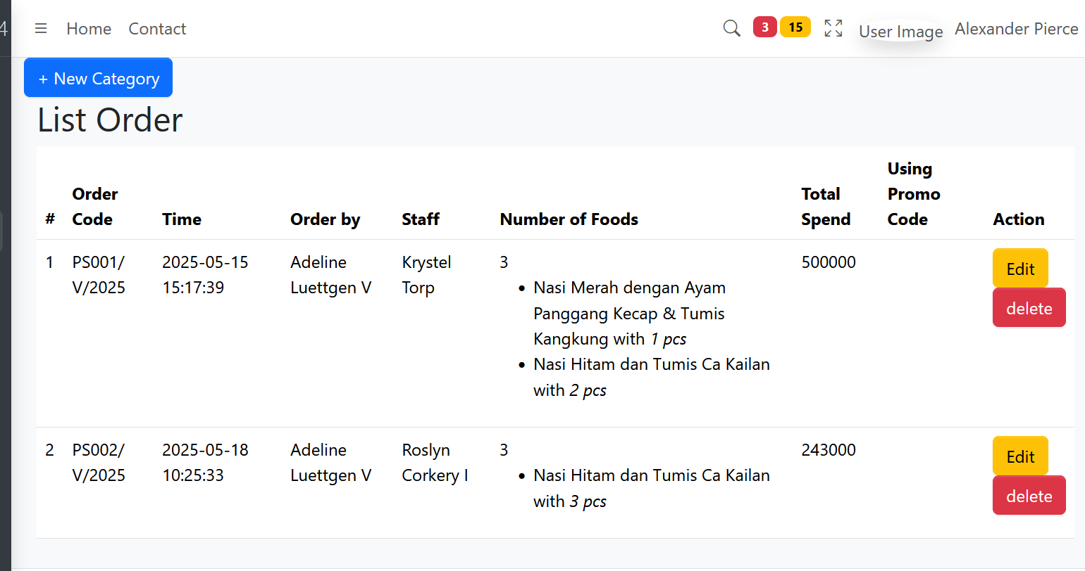

Slide 23
Start from Now!
Present your progress with your friends and your lecturer
Always stay tune in Laravel documentation
Give your good question from your weakness or difficulties
Try to make a good UI/UX from boostrap element
Select (https://www.w3schools.com/html/html_form_elements.asp)
Select2 (https://select2.org/)
Radio button (https://www.w3schools.com/tags/att_input_type_radio.asp)
Checkbox (for many-to-many like order and food case study) (https://www.w3schools.com/tags/att_input_type_checkbox.asp)
Informatics Engineering | Universitas Surabaya

Slide 24
Thanks.
Informatics Engineering | Universitas Surabaya

